Slide 1
Apocalypse Internet, Chinese Motorcycles, and Traffic-Mimicking Malware
awgh@awgh.org
https://github.com/awgh/ratnet
#ratnet on freenode+hackint
Notes:
Real talk people. I want all of you to repeat something to yourself any time you think this might be a talk about malware. It can’t be malware if you have love in your heart. And I do.
Introductions: I’m awgh, I’m from IRC.

Slide 2
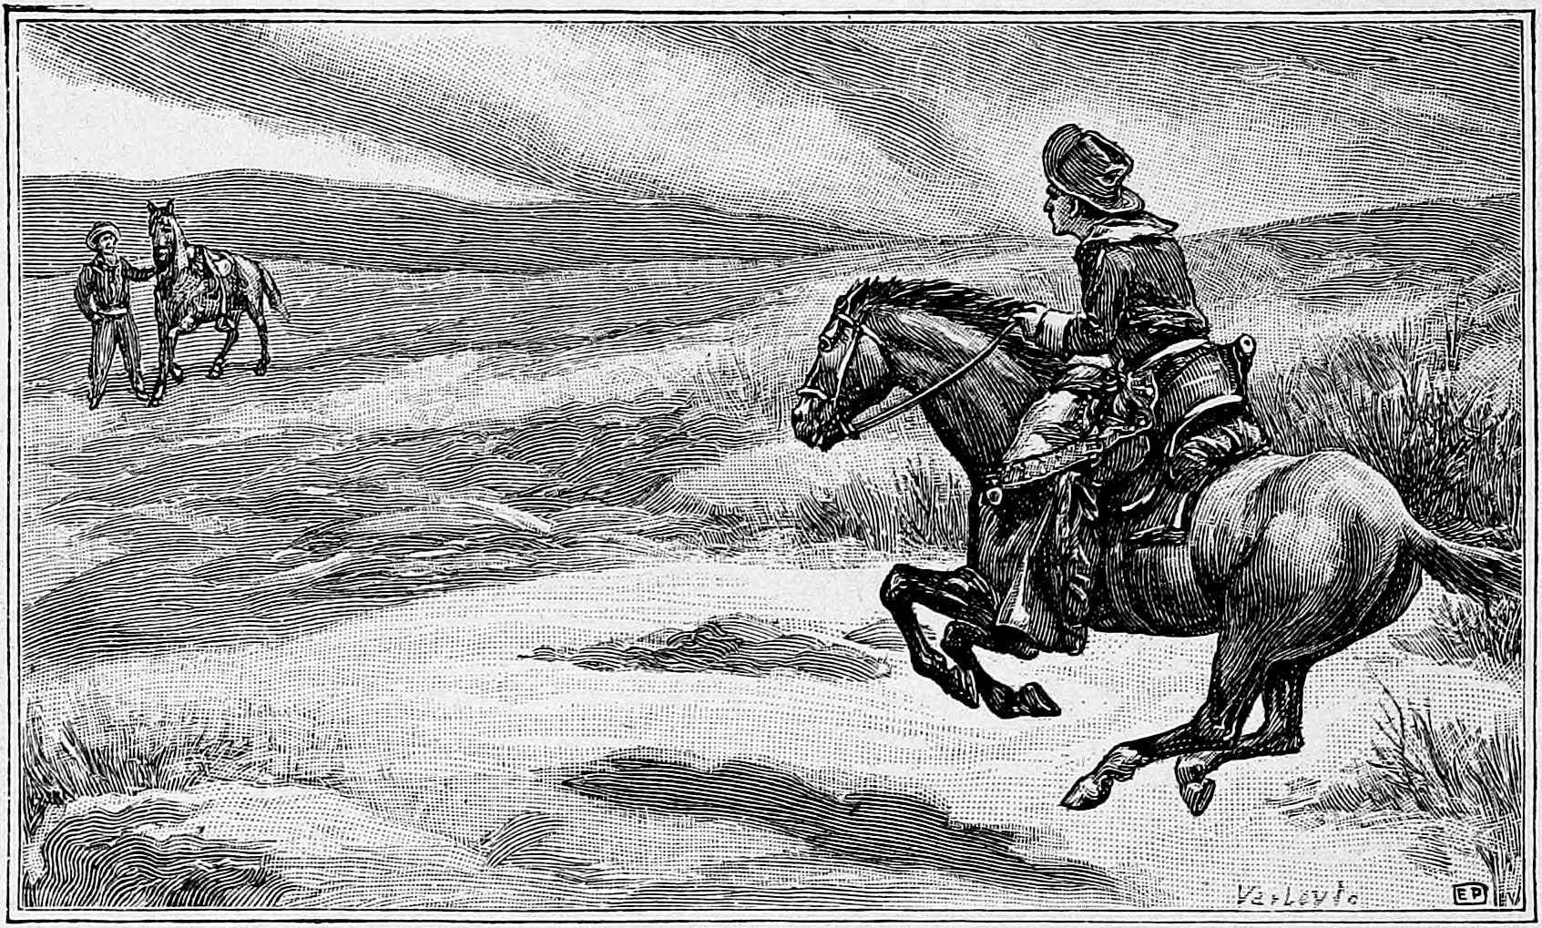
Walking Dead: Why No Network?
there are alternators and old phones everywhere
Notes:
You ever wonder why in the walking dead, when they need to send a message from the Kingdom to the Hilltop or whatever, they need to send a dude on an extremely edible horse to physically ride over there through a sea of zombies?
I thought hey, if there was one repo you should have already synced before the zombies eat GitHub, what would it be?

Slide 3
Mobile Meshing Solution =
Ready for the Zombies
Notes:
Clearly you need a solution for mobile meshing using hardware you can find lying around to be ready for the inevitable zombie apocalypse.

Slide 4
Ratnet: Big Picture
We developed a messaging middleware, Ratnet, with every design decision made to make it very difficult for messages to be detected or selectively blocked on adversarial networks and noticed it was also ideal for some other use-cases…
It also supports scenarios where there is no network available at all, such as wifi mesh or even unidirectional hops (radio/USB/laser).
TL;DR: It’s mesh-radio onion-routed FidoNet (although flood routed, so no source paths).
Notes:
So that’s what we made. Ratnet is a mesh-radio, flood-routed, onion-routed, store-and-forward messaging system. It also works as a library for communications across regular networks where you’re worried someone might be trying to detect or block you. (But with love.) We’ll be getting into the details on all of that later… but first, let’s talk about the meshing scenario.

Slide 5
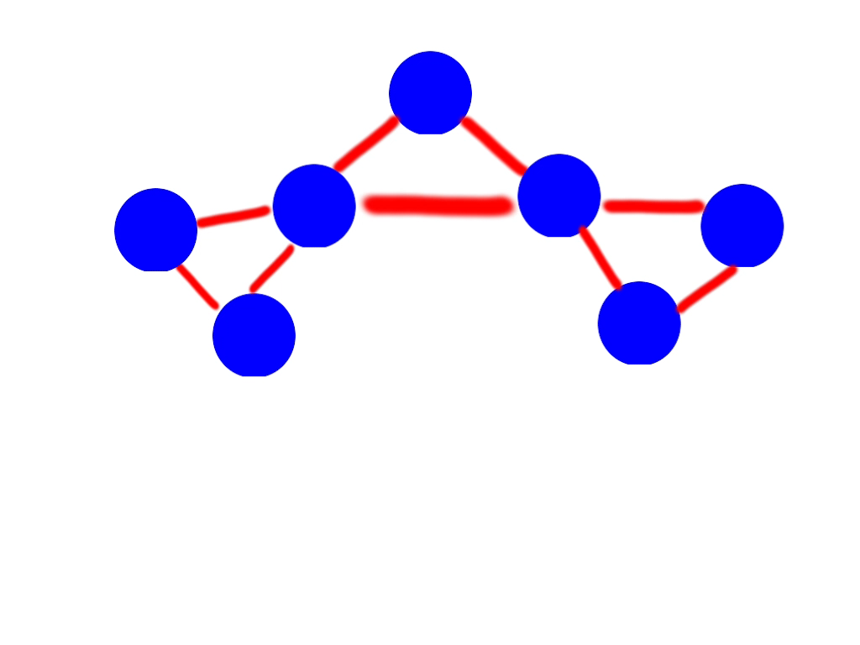
Notes:
Pretend the blue circles are mesh nodes. In the beginning, they’re all able to route to each other, and they can route to the Internet. ADVANCE
As the two groups move around, they lose touch with the Internet, but can still talk to each other.
Finally, when the two groups move out of range of each other, they can still talk amongst themselves, but no longer between groups. This is what we call the “offline meshing” scenario. The important thing to note is that there can be no guarantee that any message will ever be delivered.

Slide 6
Notes:
A practical use case in a city might involve installing a mesh node in a city bus, which makes regular loops through the city every few hours. As it passes other nodes, it exchanges messages. So it would be possible to establish a slow way of exchanging messages with very little in the way of infrastructure. Infrastructure cost of this network is about $30.

Slide 7
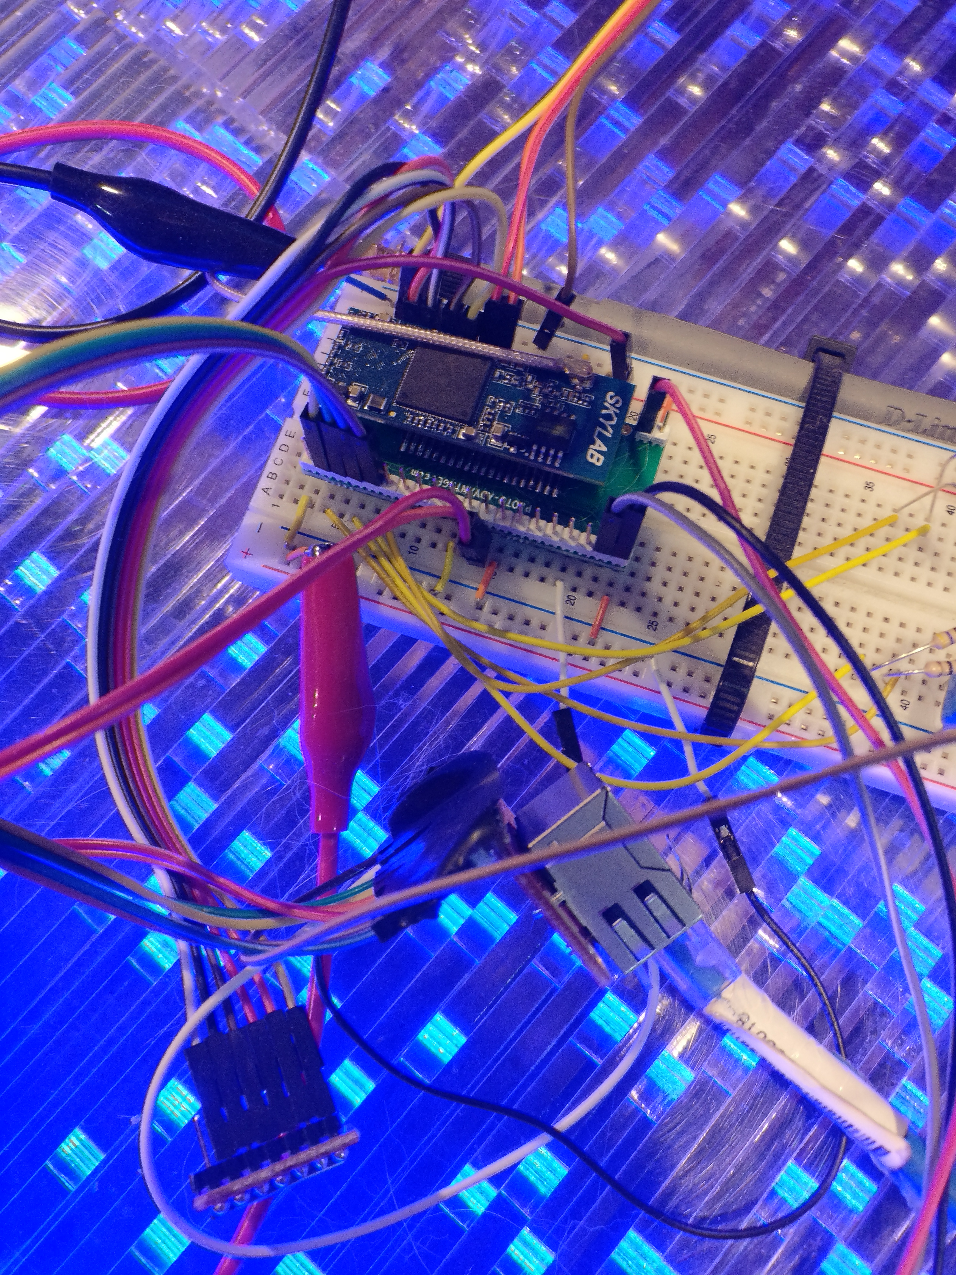
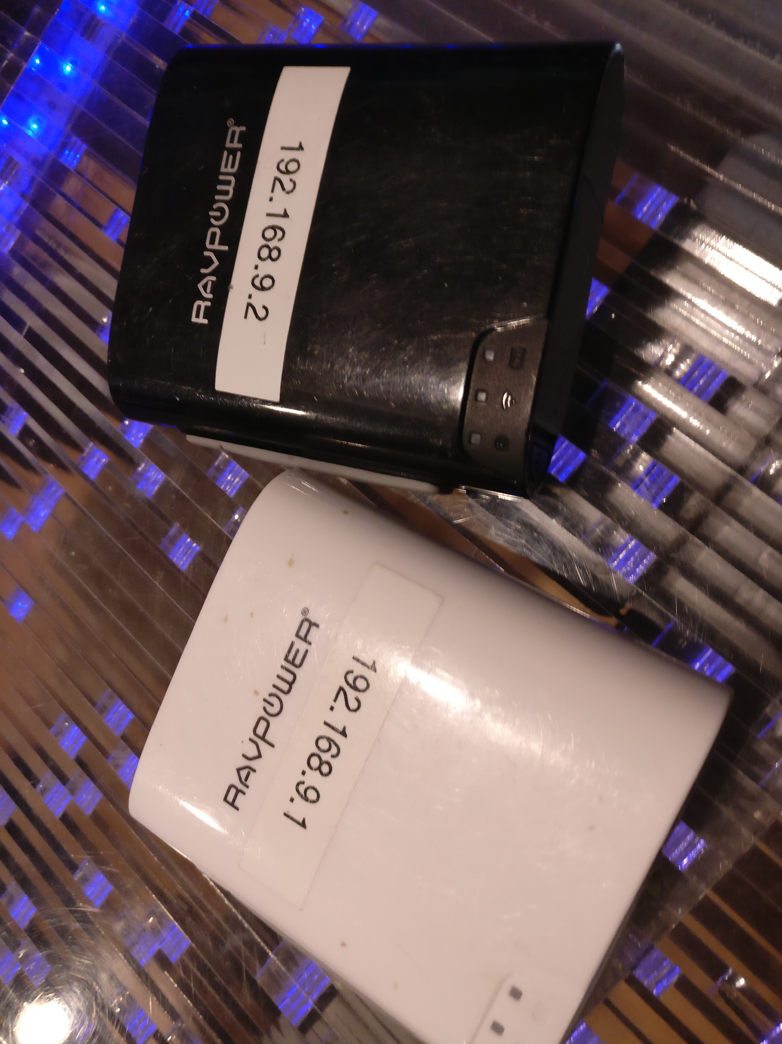
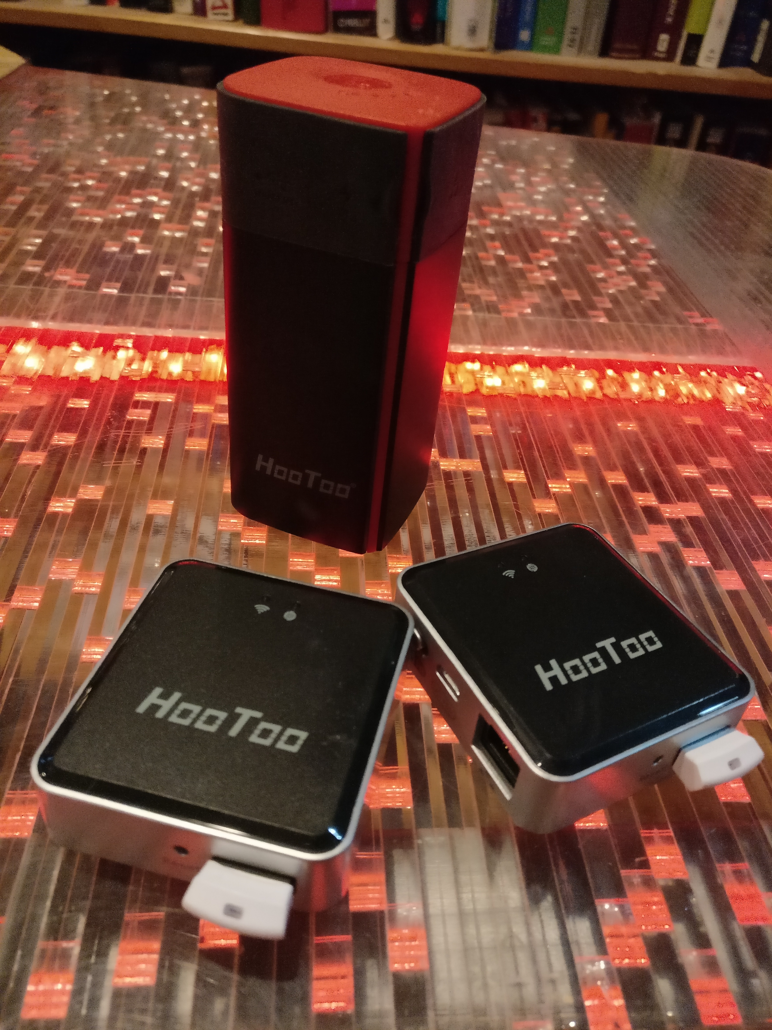
Notes:
All the code is written in Go and we cross-compile it to run on little MIPS32-SoftFloat boards all the time.
RAVPowers with battery and OpenWRT
$17 HooToo’s with no battery
Custom board in development for use as con badge
OpenWRT is optional, but makes the 802.11s meshing easy to set up
Also tested on Androids back to 4.1 and PC, every other platform should work.

Slide 8
Go Get The Code
Follow along at home:
https://github.com/awgh/deaddrop
https://github.com/awgh/ratnet
https://github.com/awgh/hushcom
https://github.com/awgh/filefountain
https://github.com/awgh/bencrypt
Notes:
Before we go any further, if you’re already getting bored, just go check out the code.
It’s a-w-g-h on GitHub, check out the docs folder in the Ratnet project and the Readme for links to other related repos.

Slide 9
Deaddrop Demo
https://github.com/awgh/deaddrop
Chunks and transfers files using Ratnet
Sparse files not platform-independent, so just keeps chunks as files until they’re all together
Runs fine on the mips32-softfloat RavPower RP-WD02
Had to invent a new version of the NZB file format from Usenet… NZB requires all segments to be listed in XML… I just require the range of valid sequence numbers not in XML -> my headers are a fixed size!
Notes:
There is a working demo of live file transfer between two Ratnet nodes in the Deaddrop project. The project is expecting to be set up on a configured 802.11s node, and then it uses peer-to-peer discovery to bootstrap once the mesh connection is established. etc etc

Slide 10
Background

Slide 11
CIA+D
Confidentiality - This means secret.
Integrity - This means non-tamperable.
Authenticity - This means that the sender can’t be spoofed, commonly implemented as a signature. (DANGER: Might Leak Sender in the Clear)
New: Deniability - Looking at just the packets on the wire, the network owner shouldn’t be able to tell who sent or received a message - even with some recovered routing keys (like if some routers get captured).
Notes:
You might be familiar with the usual Axioms of crypto: Confidentiality, Integrity, and Authenticity.
For purposes of this project, we add a fourth axiom: Deniability, which is a guarantee that you can’t tell who the sender or intended recipient are from looking at packets on the wire. Deniability should also be upheld if an intermediate router is captured and used as a MitM. You can also think of Deniability as Confidentiality for message metadata.

Slide 12
Store-and-Forward
Tor exists, we don’t need to re-invent Tor. But Tor requires sockets (live, bi-directional), and that opens up correlation attacks.
Tor is a big global network with the associated risks of homogeneity in crypto/code. Also heavy requirements (global infrastructure) and no e2e encryption.
Sockets aren’t the ONLY metaphor for network communication. We used to have thousands of modems dialing each other every night in a complex scheme manually managed by grey aliens. It was what we had and we liked it!
Store-and-forward style messaging breaks sockets, but it also allows one-way radio throws and offline meshing and kills correlation attacks by allowing messages to be batched differently with every hop*.
Notes:
People always ask Why Not Use Tor?
Short answer is that Tor is designed to be a big global network, and it is married to the concept of bidirectional sockets. Well, sockets don’t work for everything, and they allow correlation attacks.
For our system, we decided to force end-to-end encryption for every message, we decided to allow purely one-way transport hops like lasers or USB keys, and we wanted to support mobile meshing scenarios without relying on infrastructure. So we went back to an older metaphor for communication - the store and forward network. Like FidoNet or Newsgroups, each node stores as many messages as it can, and tries to route them where they need to go best it can.
* THIS COMES UP LATER wrt. MIXNETS

Slide 13
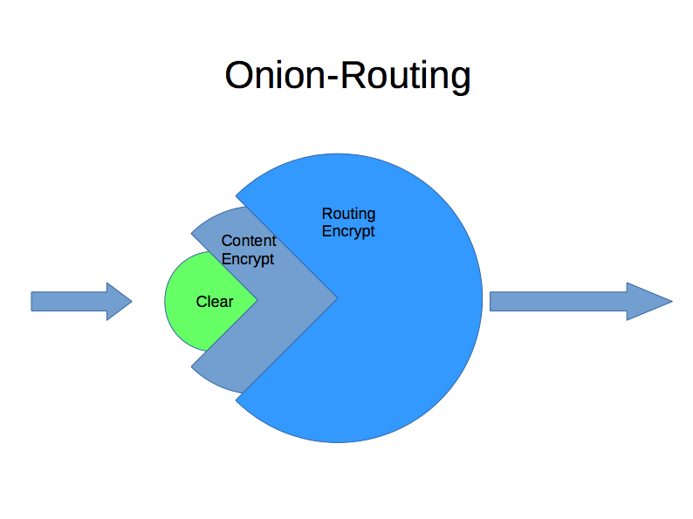
Notes:
Onion-Routing just means that messages are encrypted and decrypted between each hop. The Ratnet version of Onion Routing forces every Cleartext message to be encrypted with what we call a Content key. When those messages are sent, they are batched and encrypted again with a Routing key. Like layers of an onion.

Slide 14
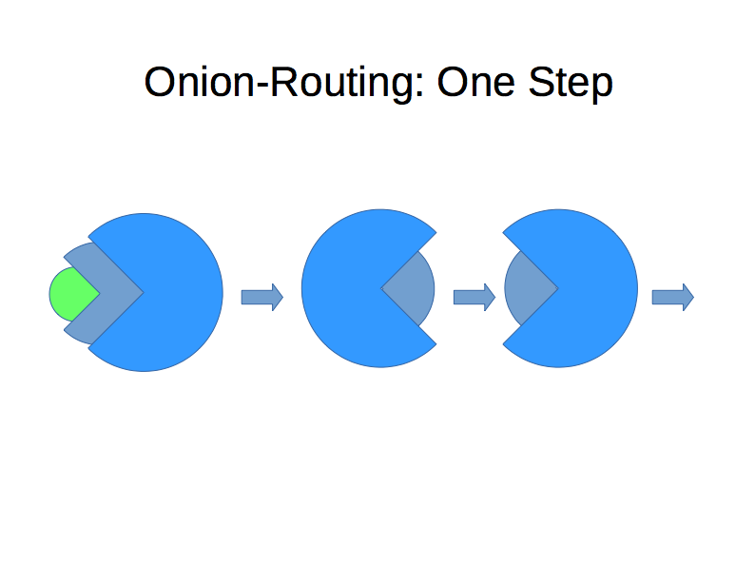
Notes:
At each hop, the message will be decrypted with the Routing key for that hop and the re-encrypted to the Routing key for the next hop. The message itself cannot be completely decrypted unless the node has the Content key, so intermediate routers have no ability to read the contents of messages.

Slide 15
Onion+Flood Routing
Onion routing, even without sockets, is required for Deniability.
Otherwise, trivial correlation attacks are possible.
However, how the heck do you do Onion Routing AND Store and Forward together? If everything is encrypted end-to-end how can an intermediate node know where to route things without violating Deniability (at content level, rather than routing) by leaving a breadcrumb (UUCP path, etc) in the message?
Therefore, the only viable routing strategy is Flood Routing (everything goes everywhere)
This is also the only viable strategy for mobile meshing. Weird.
Notes:
How can you do Onion Routing and Store & Forward together? If Deniability is enforced, intermediate nodes can’t know anything about where a message is going, so they can’t make a routing decision.
Therefore, the only valid strategy is Flood Routing, which means Every Message Goes Everywhere.
It turns out that this is also the only viable strategy for the Mobile Meshing Scenario

Slide 16
Solvable Problems
Loop Detection because of Flood Routing
Passive - Nonce hash table, requires network size (ish)
Active - Irreversible math ie. (Prime*Prime)*Prime*Prime
Many DoS risks have to be mitigated (storage/net/loop)
Deal with it at application level (same as retries)
Notes:
Flood routing causes some problems, but we can work around them.
Loop detection is a big concern, since I send a message to all my neighbors, and then repeat it to all their neighbors, the odds are good that I will get my own messages bounced back to me at some point. We have developed two strategies to deal with this:
The Passive approach saves some random bytes prepended to each message in a hash-table which allows old values to decay out. This lets us quickly detect messages we’ve already seen, but creates a limit on the size of the network based on the chosen size of the hashtable (imagine a perfect loop as the worst case scenario).
The Active approach, still an algorithm in development, uses math that is difficult to reverse to let each node mark a message as “seen” without leaking any information about who saw it. The quick version, using prime multiplication, would go:
Sender of message updates the tag field by generating two large primes and multiplying them together (remembering one of them).
Each router generates a large random prime.
When a router receives a message, it divides by it’s prime. If no remainder -> we’ve seen it. Otherwise, multiply the tag field by our prime and update.
Obviously this tag field would get big, which might be OK in some cases, but we’re shopping for better math here.
The other issue from Flood Routing is that each node has to be very careful to maintain their own resource limits to avoid Denial of Service problems.

Slide 17
Sign-cryption Deniability
Something static on the outside of the encrypted message part must indicate which public key to use for the signature validation.
Something static is something that can be signature-matched, or might dox someone.
NaCl is a library for sign-cryption without allowing just encryption. Thanks, djb, had to write my own version.
We have a solution for this problem… Each message begins with a random nonce, followed by HMAC( nonce + intended recipient’s Public key).
Notes:
A Quick Note on Salt from DJB.
It’s a library for sign-cryption that doesn’t allow you to encrypt something without signing it. This violates Deniability, so we couldn’t use it as written.

Slide 18
Crypto (Batches & Singles)
Roughly ECIES (RSA implementation is similar, but sloooooow):
1) Generate new EC key. (Cheap!) 2) Determine shared key with public of destination. 3) Uses KDF to derive a symmetric encryption and a MAC key 4) Encrypts the message 5) Computes the HMAC digest of encrypted message 6) Outputs: SharedKey | CipherText | Digest → "Curve25519,AES-CBC-256,HMAC-SHA-256", etc.
Notes:
The actual encryption system we use most often is an implementation of the Elliptic Curve Integrated Encryption Scheme using Curve25519, AES-CBC-256 and HMAC-SHA-256
There’s an RSA implementation in the code, too, which is similar, but slow and sad, especially on MIPS32-SoftFloat

Slide 19
One Message, One Hop
Notes:
To get a sense of how the system works, we’re going to go through the sending of one message.

Slide 20
Decided to solve every problem with an additional layer of abstraction, and ended up with five APIs.
Application
1.
Ratnet API
2.
Crypto
3.
Node
4.
Connection Policy
5.
Network Transport
Notes:
There are 5 different steps a message goes through when sent by an application, and each of those steps use an internal API that there are at least two implementations of.

Slide 21
Application
Your application calls the Send method via local library call or via an “admin” port using any transport plugin.
Send( to, cleartext_msg )
1.
Ratnet API
2.
Crypto
3.
Node
4.
Connection Policy
5.
Network Transport
Notes:
First step, the application calls Send with the intended destination key ID and the clear message.
The application can call into Ratnet directly as a Go library or over a remote Admin connection using any of the transport plugins. Oh yeah, there are transport plugins. We’ll get to that.

Slide 22
Application
The Ratnet module acts as a KSM/keyring and retains the public keys for known recipients, routing keys, and content keys.
The Crypto interface is abstracted with two provided implementations: ECC and RSA
However, to implement your own, you only need to override GenerateKey, Encrypt, and Decrypt.
Routing and Content Crypto can use different implementations!
1.
Ratnet API
2.
Crypto
3.
Node
4.
Connection Policy
5.
Network Transport
Notes:
Ratnet also acts as a keyring, so it pulls the public Content key for the given destination ID and encrypts the message to that key. As I mentioned before, the Crypto interface is just an internal API. Also, the routing and content Crypto instances are different, so you could use ECC for the Routing layer and RSA for the content, for example.

Slide 23
Application
The message is encrypted to intended recipient with the content key and added to the “outbox” queue with a timestamp (doesn’t have to be real time).
The queue action goes to another internal API, which has two provided implementations:
QL - Database-backed Node
Ram - RAM-Only Node
1.
Ratnet API
2.
Crypto
3.
Node
4.
Connection Policy
5.
Network Transport
Notes:
Once the message is encrypted, it’s added to the internal “outbox” queue with the local timestamp from when it was queued.
The Queue itself is also abstracted with two implementations: one is backed by a pure-Go database, and one exists only in Ram. Depends on if you want persistence or if you really don’t want persistence… in a loving way of course.

Slide 24
Application
Connection Policies run on their own threads and determine how and when messages are dequeued and transmitted.
Three provided Connection Policies:
Polling Client -
every X minutes, push/pull with every given host
Server -
just a regular listening port
P2P -
implements host discovery via mDNS*, then chains to any other Transport.
also this is an API and you can write your own easily…
1.
Ratnet API
2.
Crypto
3.
Node
4.
Connection Policy
5.
Network Transport
Notes:
Each Ratnet node can be configured with any number of Connection Policies, which define how they interact with other Ratnet nodes. This is another easily overridable abstraction, with three implementations:
Polling - which says every X seconds, phone out to peers and push/pull messages.
Server - which says sit and listen for others to push/pull.
P2P - which does some mDNS magic to find peers, then negotiates who goes first, then push/pulls messages.

Slide 25
Application
Two provided Transports:
SSL - auto-generates certs, ECC/RSA mode
UDP - uses a reliability/multipacket layer
1.
Ratnet API
2.
Crypto
3.
Node
4.
Connection Policy
5.
Network Transport
Notes:
Finally, when the actual message exchange goes down, it happens through another abstraction - the transport plugins.
Two implementations are provided, using TLS (although we’re not relying on that encryption) and UDP with a reliability layer. It’s easy to add your own, and we’ve prototyped DNS, QUIC, SneakerNet/USB-Stick and IRC transports. Teredo and IPSec would be cool… more on this later.

Slide 26
Application
Application
1.
Ratnet API
2.
Crypto
3.
Node
4.
Connection Policy
5.
6.
Network Transport
Network Transport
Notes:
So then the transport plugin actually transports.

Slide 27
Application
Node Public API exposes 3 ops:
Get Public Routing Key
Pickup Messages since time -> returns time
Dropoff Messages
On Pickup, messages are batched and encrypted with Routing Key.
Application
1.
Ratnet API
2.
Crypto
3.
Node
4.
Connection Policy
5.
6.
Network Transport
Network Transport
Notes:
The API that’s exposed between Ratnet nodes only has three operations:
PubKey, which returns the Routing pub key.
Pickup, which takes a pub key and batches up all messages and encrypts them to the given key.
Drop-off, which accepts a Routing-encrypted batch of messages.

Slide 28
Application
Dropoff is called on the recipient’s Public API.
Message-Batch is decrypted with Routing Key.
Each Message nonce is hashed with each Public Content Key, and if there is a match, the relevant callback to the Application is called to deliver the Message.
The original encrypted Message may be added to the outbox queue for this node (unconsumed messages, messages w./multiple recipients or whitenet reasons).
6.
Network Transport
Notes:
The final step is when Drop-off is called with a batch of messages. The batch is decrypted with the Routing key, then each message nonce is hashed with each of this node’s Content Pubkeys. If there is a match, the message is decrypted with the appropriate key and returned to the application via the callback associated with that Content key.
Depending on network settings, consumed messages may be forwarded on. Could be a shared key, could be for white-net reasons or to screw with correlation attacks.

Slide 29
Nifty Design Bits
All possible Connection Policies have to use only three API calls: Pickup, Dropoff, and get Routing Public Key
Polling is just [remote Pickup]->[local Dropoff] then [local Pickup]->[remote Dropoff] since the Connection is just a thread calling into both local/remote APIs.
Pickup has a “since timestamp” optional argument, and Dropoff returns the local timestamp of last message added.
So remembering one timestamp per other node is enough for zero overlap and clock skew doesn’t matter anymore.
Notes:
Couple of weird design decisions had to be made.

Slide 30
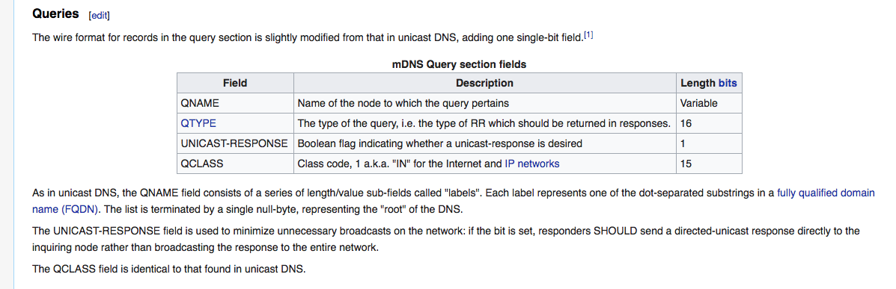
Being Sneaky w./ mDNS
The UNICAST-RESPONSE field is used to minimize unnecessary broadcasts on the network: if the bit is set, responders SHOULD send a directed-unicast response directly to the inquiring node rather than broadcasting the response to the entire network.
This part of the mDNS spec is meant for non-compliant devices to indicate that they are non-compliant, so they won’t show up in mDNS auto-enumeration.
Notes:
The peer-to-peer plugin does a neat trick with mDNS. We needed some multicast and didn’t want to add a requirement that we run as root, and there’s a nice hole for non-root multicast via mDNS on everything these days. READ SLIDE

Slide 31
Nobody here but us non-compliant mDNS clients…
The P2P Connection Strategy automatically alerts peers by sending a multicast mDNS query with:
Unicast bit set (this means that it won’t show up in the OSX Finder or similar mDNS clients - any responses will come back as Unicast)
Encoded port & IP of this peer
Encoded random number (whoever has the highest goes first)

Slide 32
Adversarial Networks
Notes:
Now that we understand the thingie, let’s talk about how we can use this for evasion on adversarial networks.
So… what makes an adversarial network adversarial? Mainly, we think about automated network detection systems like IDS, but it can also include firewall rules or DNS trickery. Certainly all of those tricks have been employed on corporate networks and also in places like Iran around election time.

Slide 33
IDS < Math
Intrusion Detection Systems have always failed and will always fail because of the difference in algorithmic complexity between simply sending a packet and having to analyze it (match against sigs? measure entropy?).
IDS also has some finite amount of RAM, which means that it must have limits on how long it keeps network state information. There are no limits to how slow we can go.
So… traditionally, going too fast will make an IDS crash*, and going too slow will avoid triggering any of their signatures. (*saturate the input lines and see)
Notes:
Read slide fast.
AFTER FIRST BULLET: Sending is constant time and can be offloaded to hardware, Matching with a compiled regex is in theory O(N) for DFAs, although PCREs are Turing-powerful and may not even halt. Guess which one your IDS uses. Both suck: DFAs are too limited, PCRE is too slow & heavy.

Slide 34
IDS meh
The more signatures enabled, the less effective/efficient.
Also, it needs static signatures, any extra computation makes the problem worse. They ain’t measuring entropy
Doesn’t really handle encrypted traffic, other than endpoints (but… that’s a job for network ACL/firewall)
The best use of IDS has always been with a small number of DDoS signatures that essentially trigger the rerouting of flood traffic. This actually works pretty well.
Notes:
READ SLIDE
Also, who looks at logs, how many false positives, etc.

Slide 35
Easy Enough
To avoid static signatures for Regex IDS:
Store-and-Forward allows us to go very, very slowly.
Each message begins with a random nonce, followed by HMAC( nonce + intended recipient’s Public key ). All high entropy.
Everything after that is encrypted, so the entire payload is essentially just random bytes. Same message sent twice will be different bytes.
Downside is that every receiver incurs the cost of a hash check to see if an incoming message is for them.
Upside is we can use the pluggable transports to smuggle our high-entropy blob in any other encrypted protocol (SSL, IPSec, etc.)
Notes:
READ SLIDE fast.

Slide 36
Prophecy of the Behavioral IDS
To address the issue of “how do you know an attack is happening if you don’t have a signature already”, many have attempted* to make IDS that will monitor the network to establish a baseline, and then trigger on unusual activity.
Usually these solutions involve sending your network traffic (*ahem* metadata) to the cloud and then machine learning, ???, and profit.
The dream is that the system can match a previously unknown attack on one tenant and then somehow make/distribute sigs. * Black Hat vendor area is full of lies.
Notes:
Read slide fast.

Slide 37
Still Easy
To avoid those Behavioral IDS (in the event they start working), you’d really just need two things to beat such a janky heuristic algorithm:
A way of determining the network baseline for “normal” traffic (protocols, endpoints in various cloud providers, flows that are commonly encrypted, etc.)
A large collection of transport plugins, so that you could pick out ones that would look normal on this network.
Notes:
READ SLIDE

Slide 38
Network Fingerprinter
https://github.com/awgh/nfp
Just feed it a pcap, or it will sniff for X seconds…
Generates a report breaking down what type of traffic is common on this network.
Pays attention to protocols that are commonly encrypted, since those are the most promising to mimic (esp. if cloud): IPSec, TLS/SSL, Teredo, IPSec-over-Teredo, SSH
Also flags all DNS lookups, Client Hellos, LLMNR, HTTP, *
Future work: Flag all endpoints in cloudapp or AWS, etc., to see what cloud providers are explicitly allowed on this network.
Notes:
READ SLIDE

Slide 39
Teredo
IPv4 to IPv6 transitional gateway
Many public gateways, easy to run your own
IPsec over Teredo is a thing… good luck with that, IDS
Also… it’s a commonly used thing for certain types of devices, so might already be white-listed
Notes:
Quick note about Teredo. It’s an IPv4 to IPv6 bridge with several publicly-available gateways that might be whitelisted.
Also, IPSec-over-Teredo has become a bit more common, and an IDS won’t be able to tell if the encrypted traffic to the public endpoint is legit.

Slide 40
OK… so we can do mobile mesh routing and hide from IDS with the same thing… What else could we do?

Slide 41

Notes:
Sweet pre-1922 Public Domain Memes, Yo.
Let’s Get Weird.

Slide 42
Mix networks are routing protocols that create hard-to-trace communications by using a chain of proxy servers known as mixes which take in messages from multiple senders, shuffle them, and send them back out in random order to the next destination (possibly another mix node). This breaks the link between the source of the request and the destination, making it harder for eavesdroppers to trace end-to-end communications. Furthermore, mixes only know the node that it immediately received the message from, and the immediate destination to send the shuffled messages to, making the network resistant to malicious mix nodes.
Each message is encrypted to each proxy using public key cryptography; the resulting encryption is layered like a Russian doll (except that each "doll" is of the same size) with the message as the innermost layer. Each proxy server strips off its own layer of encryption to reveal where to send the message next. If all but one of the proxy servers are compromised by the tracer, untraceability can still be achieved against some weaker adversaries.
The concept of mix networks first described by David Chaum in 1981. Applications that are based on this concept include anonymous remailers (such as Mixmaster) and onion routing (including Tor).
- Wikipedia
Notes:
David Chaum’s Mixnet paper from 1981… defines Mixnets as a chain of proxy servers that take in messages from multiple senders, shuffle them, and send them back out in a random order.
In this scheme, each message is encrypted with one key for each proxy-stage it will go through, and each mix node that handles a message will unwrap one layer of encryption until the end. Tor uses this type of scheme, with a 3 stage minimum (IIRC).

Slide 43
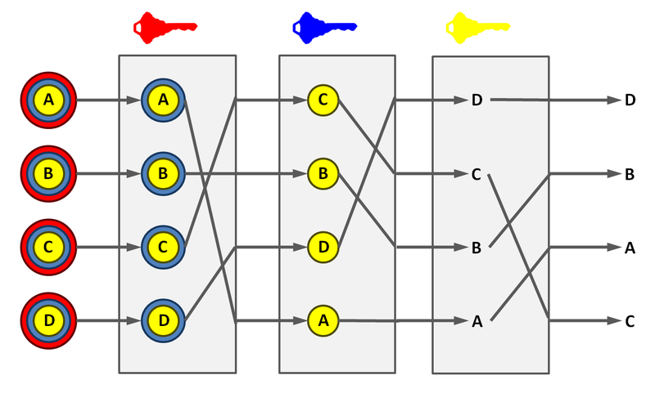
Notes:
So here’s what a Mixnet might look like, with each round of mixes decrypting one layer.

Slide 44
Procedural Generation of Mix-nets
We don’t have stages with stage keys, but we can generate arbitrary networks of cloud nodes where each node only has the pub key of it’s neighbors, and messages are randomly batched, mixed, and duplicated onto different channels with each hop.
Can generate arbitrarily large mix networks, with arbitrarily long delays. Can use different transports for different hops and can DYNAMICALLY CHANGE TRANSPORTS.
Could implement the stage keys for Chaum-compliance inside the app, using staged Content Keys (not yet done).
Notes:
Oh yeah, so we can also do scripted generation, provisioning, and deployment of mix-nets… READ SLIDE

Slide 45
Rat King
Tool to design/generate network and make Dockerfiles for each graph node and manages key distribution
Tool also generates “channel” relationships between nodes, which can be used to set VLAN-like single-hop selective routes, and can do “Channel Patches”, randomization, and multiplexing and demultiplexing of channels.
Cloud Nodes can use channels to distribute messages randomly, rather than always flood routing.
Notes:
READ SLIDE

Slide 46
Still More Code
Cloud-configurable Ratnet Demo w./ Dockerfile: https://github.com/awgh/drone
Random duplication w./RAPTOR coding will make correlation attacks painful, and can help make sure there’s always enough traffic so there is never a single message in a batch. Also nice for radio or other lossy transports! https://github.com/awgh/filefountain

Slide 47
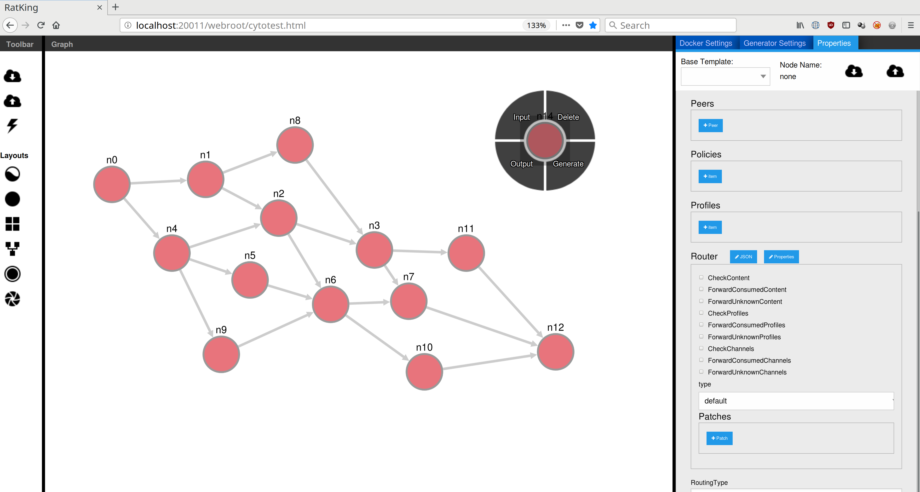
Notes:
This is a screenshot from the Ratking tool, which is a web app using Cytoscape JS that lets you manually edit your network, determine key relationships, routing rules, and so on.
It also lets you automatically script the generation of networks using Javascript, apply different layouts, and there’s a button that will run the whole network as Dockers on a remote Docker server. I want to add support for AWS and other cloud deployment option.
This is the only thing I’ve mentioned so far where the code isn’t posted right now, and that’s just because the way I write Javascript is a war crime and I need an adult. If anyone can help me organize a JS app, come say hi.

Slide 48
Thanks!
Looking for more applications, will build to suit.
Also check out DNS server for OOB XXE: https://github.com/awgh/madns
awgh@awgh.org
#ratnet on freenode+hackint
https://github.com/awgh
Notes:
I’m here hoping to get people involved in the project, mainly hoping more people will use this in their applications. I’m available to help you integrate this, and I’ll make sure our unit tests cover your application’s use cases, that kind of thing. Just give me a shout.
Also … if you’re pissed because this talk was totally useless to you, I’ve got a super useful project for helping exploit out-of-band XXEs and similar. It’s kind of like Burp Collaborator you can deploy on a VPS yourself. It’s a simple DNS server that can email you when it gets DNS requests on subdomains and some other tricks. Check out madns!

